Slide 1
Clustering of Wholesale customers - Anusuya V

Slide 2
Introduction:
Wholesale Customer dataset refers to clients of a wholesale distributor. It includes the annual spending in monetary units (m.u.) on diverse product categories. Number of Instances: 440 Number of Attributes: 8 Data Set Characteristics: Multivariate Attribute Characteristics: Integer.
Objective:
My aim is to perform clustering analysis using algorithms like hClust and kMeans .

Slide 3
About the Data set:
The data set refers to clients of a wholesale distributor. It includes the annual spending in monetary units (m.u.) on diverse product categories
Source:
Margarida G. M. S. Cardoso, margarida.cardoso '@' iscte.pt, ISCTE-IUL, Lisbon, Portugal

Slide 4
Attribute Information:
1) FRESH: annual spending (m.u.) on fresh products (Continuous)
2) MILK: annual spending (m.u.) on milk products (Continuous)
3) GROCERY: annual spending (m.u.)on grocery products (Continuous)
4) FROZEN: annual spending (m.u.)on frozen products (Continuous)
5) DETERGENTS_PAPER: annual spending (m.u.) on detergents and paper products (Continuous)
6) DELICATESSEN: annual spending (m.u.)on and delicatessen products (Continuous)
7) CHANNEL: customersâ€™ Channel - Horeca (Hotel/Restaurant/CafÃ©) or Retail channel (Nominal)
8) REGION: customersâ€™ Region â€“ Lisnon, Oporto or Other (Nominal)

Slide 5
Descriptive Statistics:
Attributes | Minimum | Maximum | Mean | Standard Deviation
Fresh | 3 | 112151 | 12000.30 | 12647.329
Milk | 55 | 73498 | 5796.27 | 7380.377
Grocery | 3 | 92780 | 7951.28 | 9503.163
Frozen | 25 | 60869 | 3071.93 | 4854.673
Detergents paper | 3 | 40827 | 2881.49 | 4767.854
Delicatessen | 3 | 47943 | 1524.87 | 2820.106

Slide 6
Region Frequency
Channel Frequency
Region | Value
Lisbon | 77
Oporto | 47
Other Region | 316
Total | 440
Channel | Value
Horeca | 298
Retail | 142
Total | 440

Slide 7
Relevant Papers:
Cardoso, Margarida G.M.S. (2013). Logical discriminant models â€“ Chapter 8 in Quantitative Modeling in Marketing and Management Edited by Luiz Moutinho and Kun-Huang Huarng. World Scientific. p. 223-253. ISBN 978-9814407717 Jean-Patrick Baudry, Margarida Cardoso, Gilles Celeux, Maria JosÃ© Amorim, Ana Sousa Ferreira (2012). Enhancing the selection of a model-based clustering with external qualitative variables. RESEARCH REPORT NÂ° 8124, October 2012, Project-Team SELECT. INRIA Saclay - ÃŽle-de-France, Projet select, UniversitÃ© Paris-Sud 11
Citation Request:
The data set is originated from a larger database referred on:
Abreu, N. (2011). Analise do perfil do cliente Recheio e desenvolvimento de um sistema promocional. Mestrado em Marketing, ISCTE-IUL, Lisbon

Slide 8
Pre-processing of the Data set
Pre-process the data set to make it suitable for further analysis of clustering of customers.
Prepare the data for analysis and Remove the missing value and remove “Channel” and “Region” columns because they are not useful for clustering.
Channel and Region attributes are Categorical Variable since it is not useful for clustering algorithm.

Slide 9
Hierarchical Clustering?
Hierarchical clustering, as the name suggests is an algorithm that builds hierarchy of clusters. This algorithm starts with all the data points assigned to a cluster of their own. Then two nearest clusters are merged into the same cluster. In the end, this algorithm terminates when there is only a single cluster left.
The results of hierarchical clustering can be shown using dendrogram.
K –Means Clustering ?
K-means is one of the simplest unsupervised learning algorithms that solve the well known clustering problem. The procedure follows a simple and easy way to classify a given data set through a certain number of clusters (assume k clusters) fixed a priori.

Slide 10
Implementation of Hierarchical Clustering
Find the distance for the data
Then apply the hclust model to the dataset

Slide 11
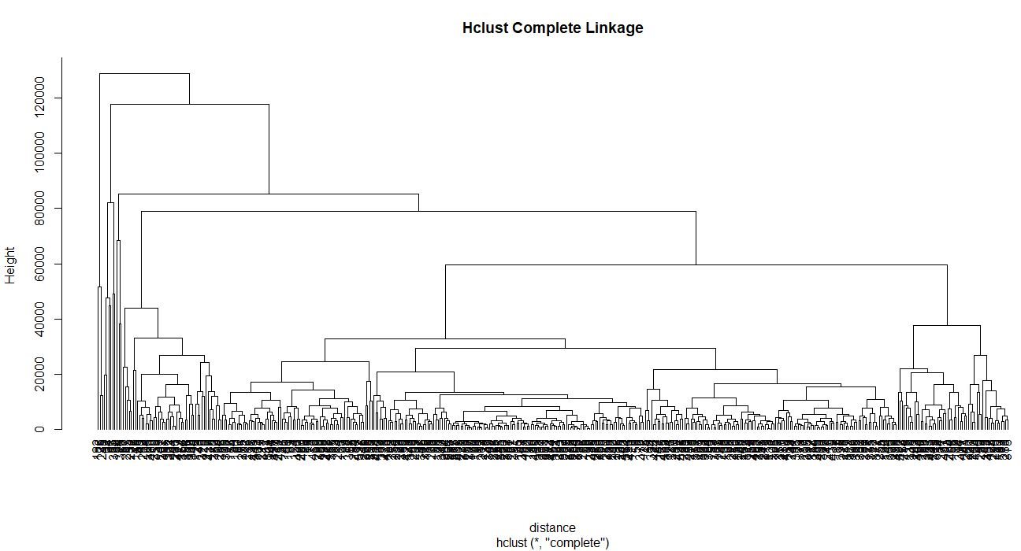

Slide 12
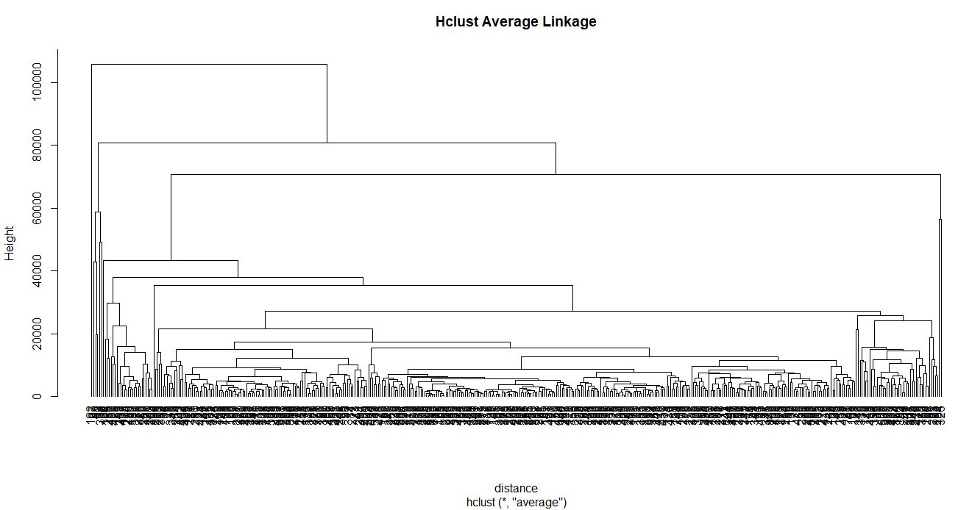

Slide 13

clustering membership for 3 cluster

Slide 14
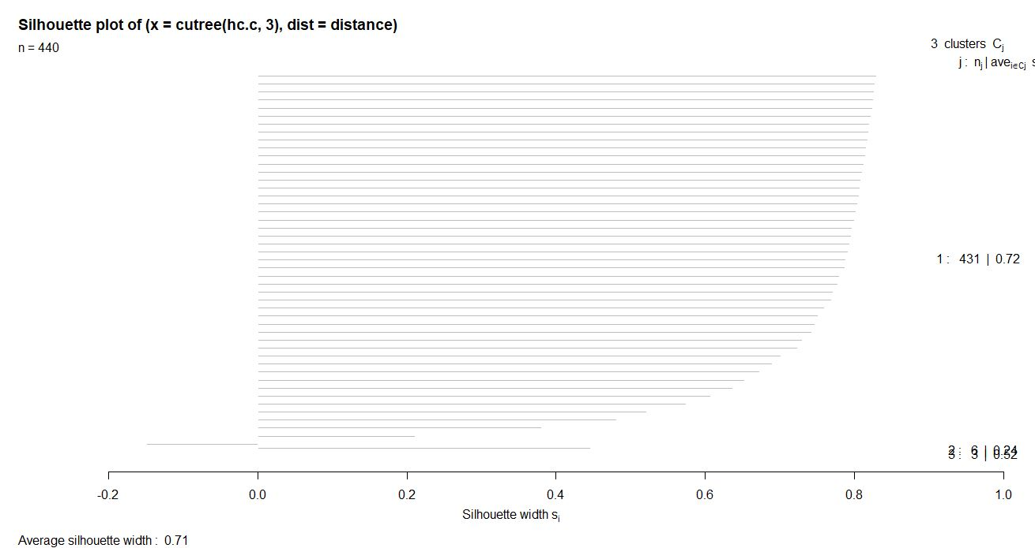
silhouette plot

Slide 15
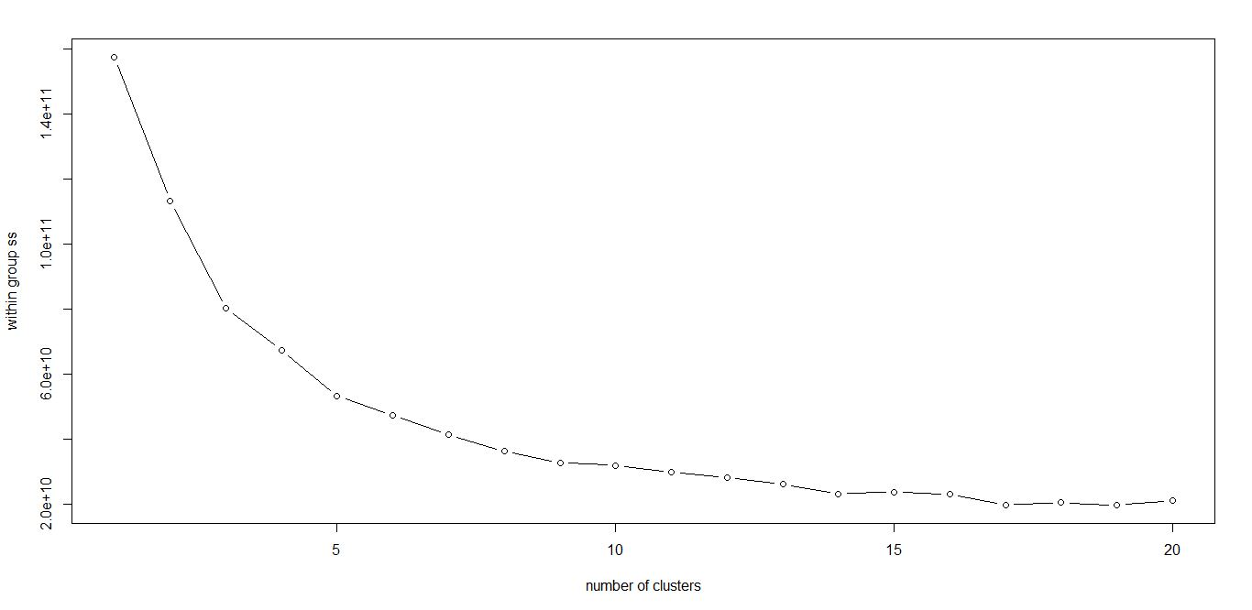
K means Clustering
Determine the K value using Within group of sum of squares (elbow method).

Slide 16
In the above scree plot the K value falls in 5.
Lets implement Kmeans clustering and plot in cluster 3 to 6 to find the difference between clustering patterns.

Slide 17
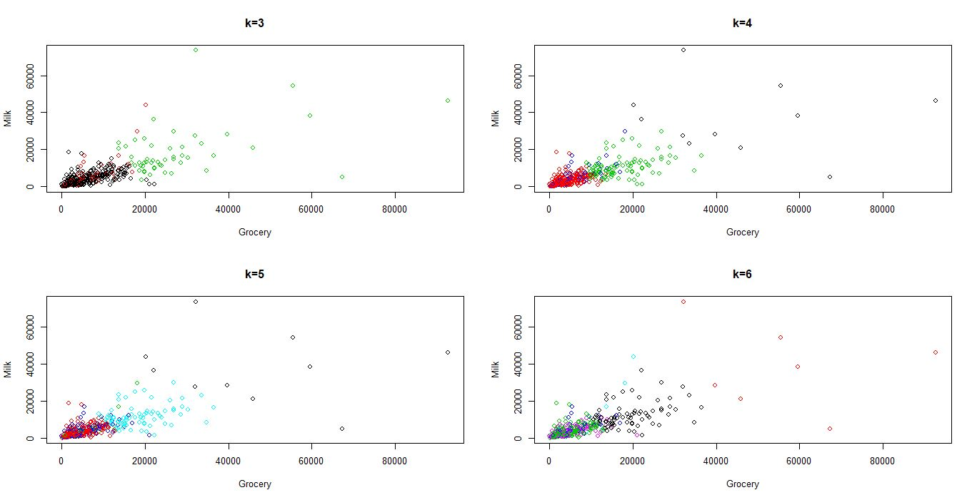

Slide 18
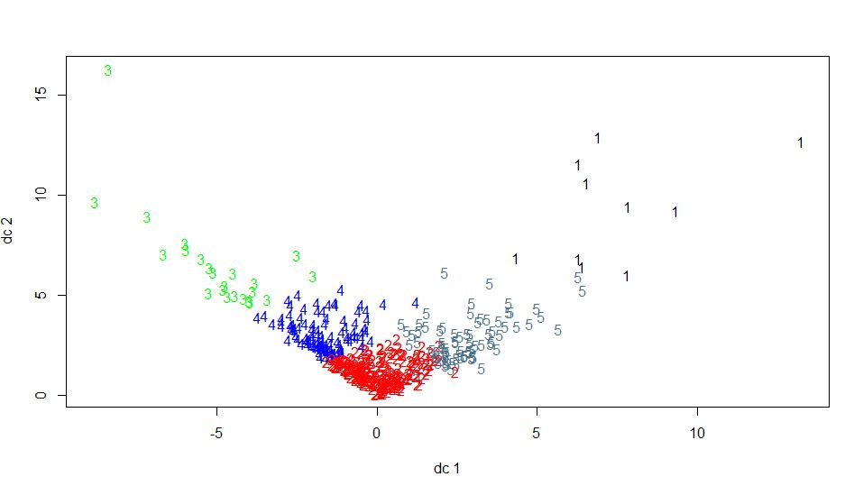
FPC plot for K=5 Cluster

Slide 19
Conclusion
I reviewed K Means clustering and Hierarchical Clustering.

